Slide 1


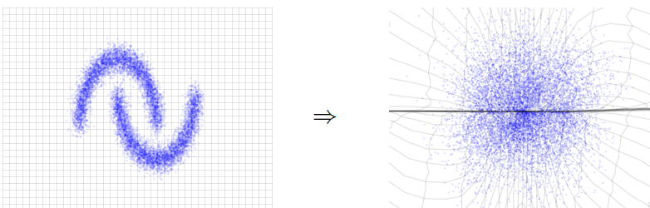
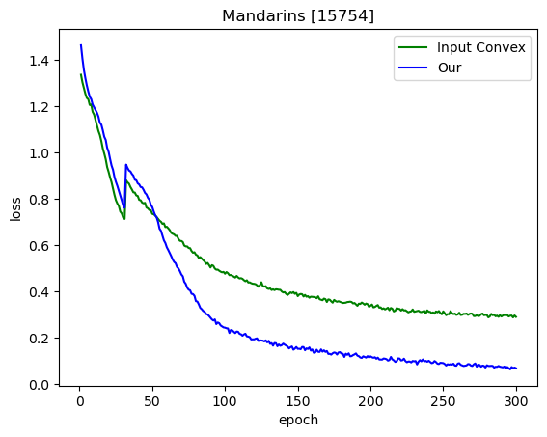
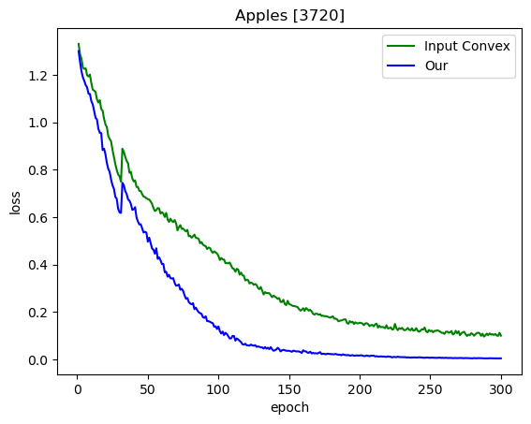
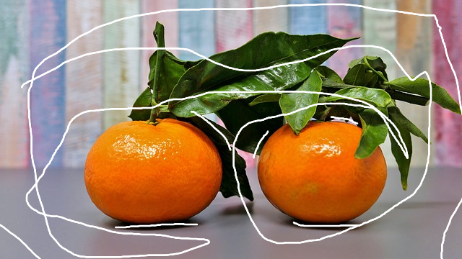
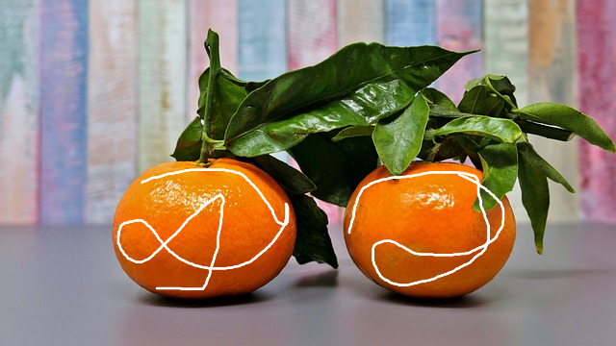
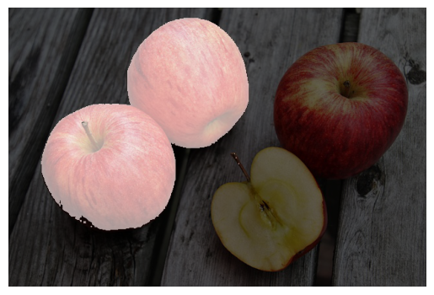
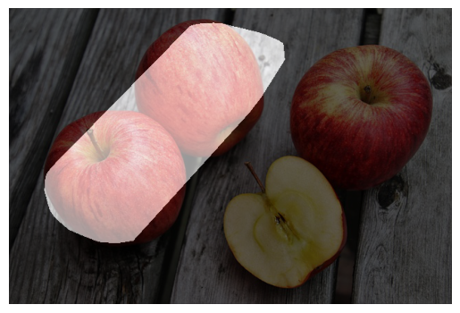
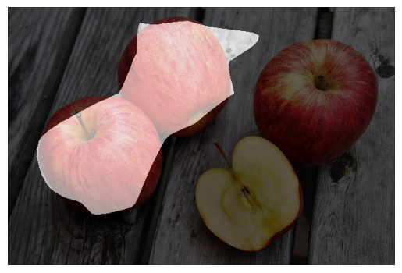
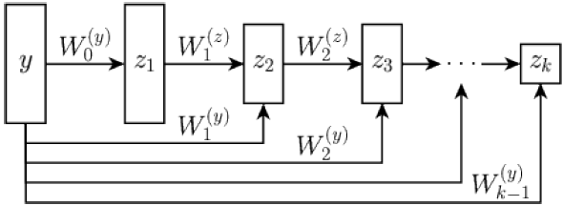
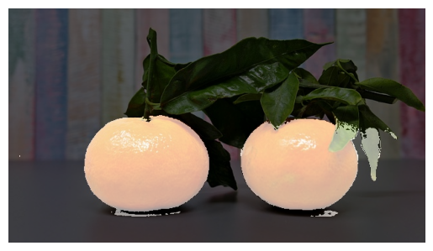
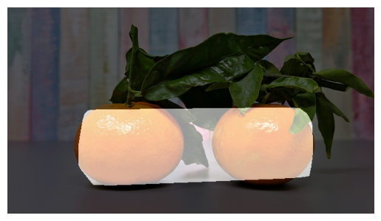
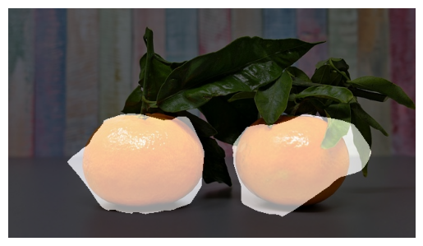

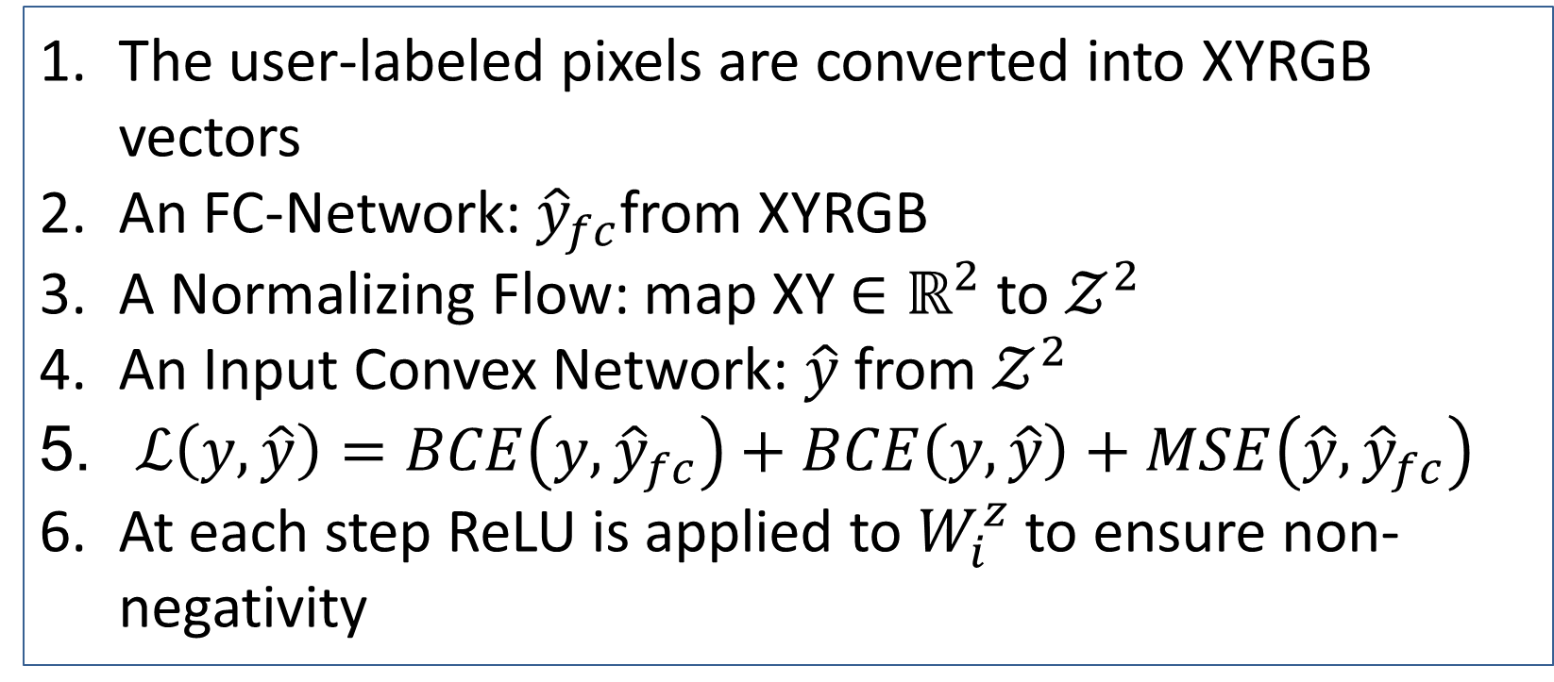
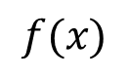

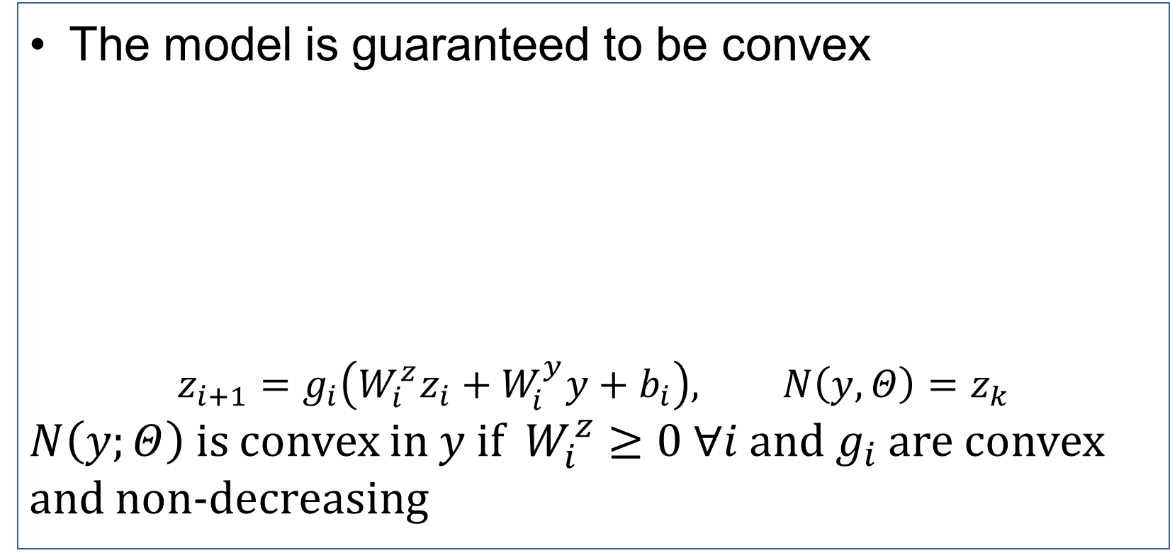
COMBINING INPUT CONVEXITY AND NORMALIZING FLOWS
Abdul-Karym Ismail Michael Moeller
Overview
Normalizing Flow^{[2]}
Numerical Results
We developed a model that is provably path connected
The model represents a composition of an Input-Convex Neural network and a Normalizing flow
The model operates in the pixel-wise framework
A Fully-Connected Network operates as a teacher to the composite model
Exactly map the input data distribution to a latent distribution
Data space Latent Space
$f(x)$ is a diffeomorphism
Training loss on the first 300 epochs
Spike on 30: addition of MSE
Our converges faster than Input Convex
Ground Truth is Fully-Connected Network’s predictions
$$f(x)$$
Scribble-Supervised Image Segmentation
Image Segmentation with two classes: background and foreground
Training data from user input (scribbles)
background foreground
Convexity and Connectedness
Constructing the model to be input-convex or path connected can help to incorporate prior knowledge about the task
Particularly important when having little training data since models can behave unpredictably and these constraints may serve as “safety” properties
The composition of an input convex model and a diffeomorphism is provably path connected
Metric | F1 |  | IoU
Dataset | Apples | Mandarins | Apples | Mandarins
Input-Convex | 0.9709 | 0.9574 | 0.9434 | 0.9183
Our | 0.9724 | 0.9527 | 0.9464 | 0.9097
Visual Results
Input Convex Neural Network^{[1]}
FC Network Input Convex Our
The model is guaranteed to be convex
$$z_{i+1}=g_{i}\left(W_{i}^{z}z_{i}+W_{i}^{y}y+b_{i}\right), N\left(y,Θ\right)=z_{k}$$
$N\left(y;Θ\right)$ is convex in $y$ if $W_{i}^{z}≥0 ∀i$ and $g_{i}$ are convex and non-decreasing
Architecture and Training
The user-labeled pixels are converted into XYRGB vectors
An FC-Network: ${\hat{y}}_{fc}$from XYRGB
A Normalizing Flow: map XY $∈ℝ^{2}$ to $𝒵^{2}$
An Input Convex Network: $\hat{y}$ from $𝒵^{2}$
$ℒ\left(y, \hat{y}\right)=BCE\left(y,{\hat{y}}_{fc}\right)+BCE\left(y,\hat{y}\right)+MSE\left(\hat{y},{\hat{y}}_{fc}\right)$
At each step ReLU is applied to $W_{i}^{z}$ to ensure non-negativity
References:
Brandon Amos, Lei Xu, J. Zico Kolter Proceedings of the 34th International Conference on Machine Learning, PMLR 70:146-155, 2017.
Dinh, L., Sohl-Dickstein, J., and Bengio, S. (2016). Density estimation using Real NVP. arXiv preprint arXiv:1605.08803.
GitHub
https://github.com/Sp00nyMan/Path-Connected-Segmentation-Network

